Slide 1

BDD and Cucumber
Ulrich Matthiae
Grant Marais
March 2018

Slide 2
What is BDD?
Stands for Behavioural Driven Development
However before you can understand what BDD is, you need to understand what TDD is
Notes:
BDD utilizes TDD in addition to other processes in order to build the right product

Slide 3
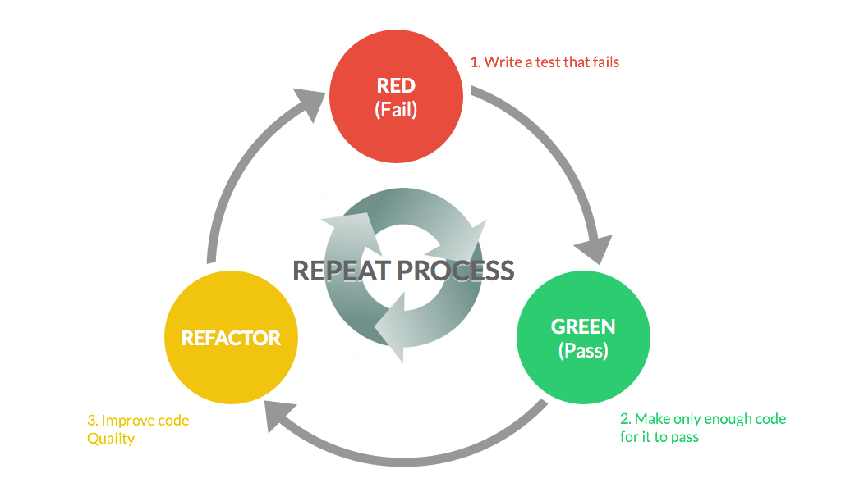
What is TDD?
Write tests first, then code to make them pass
Notes:
The classic traffic light of TDD
Give a brief explanation of how TDD works

Slide 4
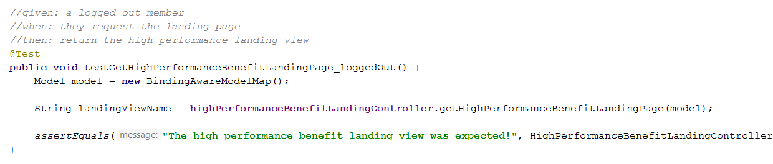
TDD Example Given, When, Then
Notes:
The given, when, then structure is the important part here
Explain how you would do TDD
The issue with classic TDD is that the test scenarios are left to a single/pair of devs to come up with. Wrong assumptions might be made
Another possible issue is that TDD is usually very granular - unit tests

Slide 5
So what is BDD then?
Sitting together as a team and creating real world test scenarios with concrete values. Developers then use these to build code that implements the behavior as outlined in the test scenarios
The team consists of:
Developers
Business Analysts
Testers
Product Owner
Any other important stakeholders
Notes:
BDD is an agile tool
You need agile in place before using BDD
NB!!! Try to keep the scenario building sessions as small and to the point as possible. Too many people = too many chefs
Don’t do bulk test automation in these sessions (the big parameterized test tables)

Slide 6
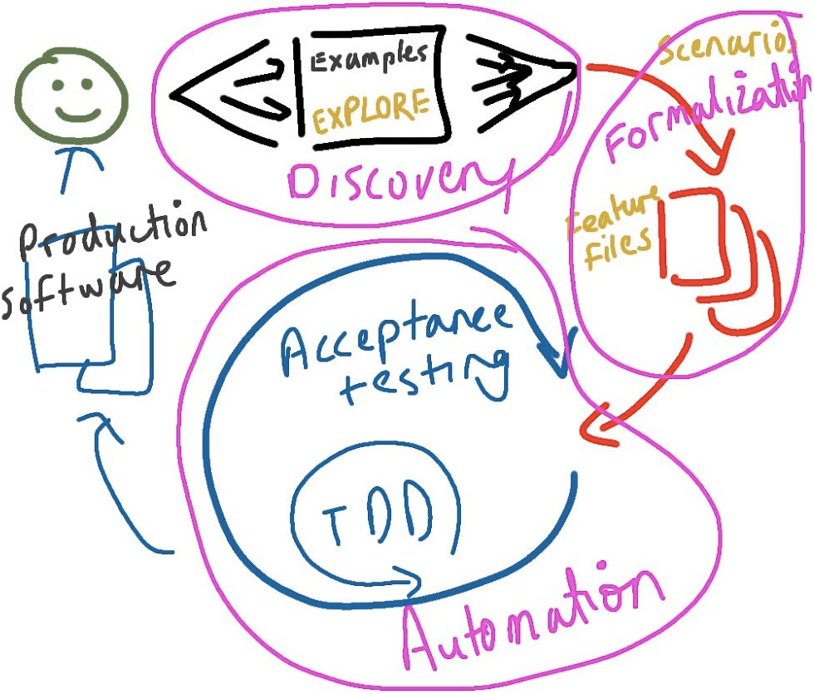
The BDD Cycle
Notes:
Explore the product that needs to built so that you understand the basic outline of it
Sit together in a scenario building session and flesh out concrete examples
Build code using the concrete scenarios using TDD, any test automation that makes sense and UAT
Deploy and go home ☺

Slide 7
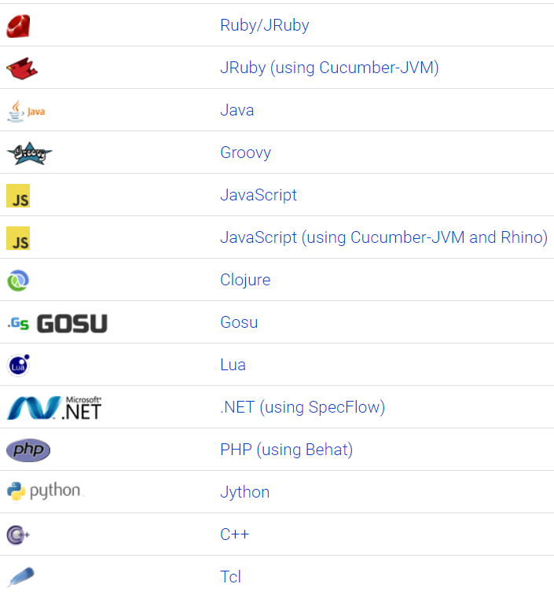
BDD using Cucumber
Notes:
Using cucumber you can easily manage and refactor your BDD test scenarios and features
Many languages are supported, we will be looking at the Java implementation

Slide 8
The cucumber components Overview
Gherkin syntax
Scenario
Executable specification
Feature file
Glue code / Test steps
Notes:
There are many frameworks to perform BDD, cucumber is just one of them.

Slide 9
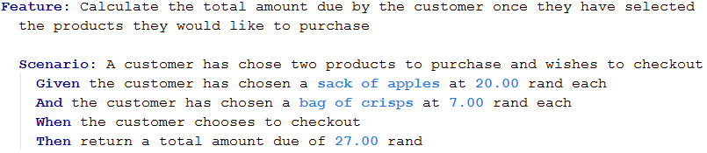
The cucumber components Feature files and gherkin syntax
Notes:
Note that a broad explanation of the feature being built is included at the top
Your scenario should be concise and be a concrete example with real values
Also note that gherkin syntax is almost the same as regular English
The whole feature file forms part of the executable specification of your application

Slide 10
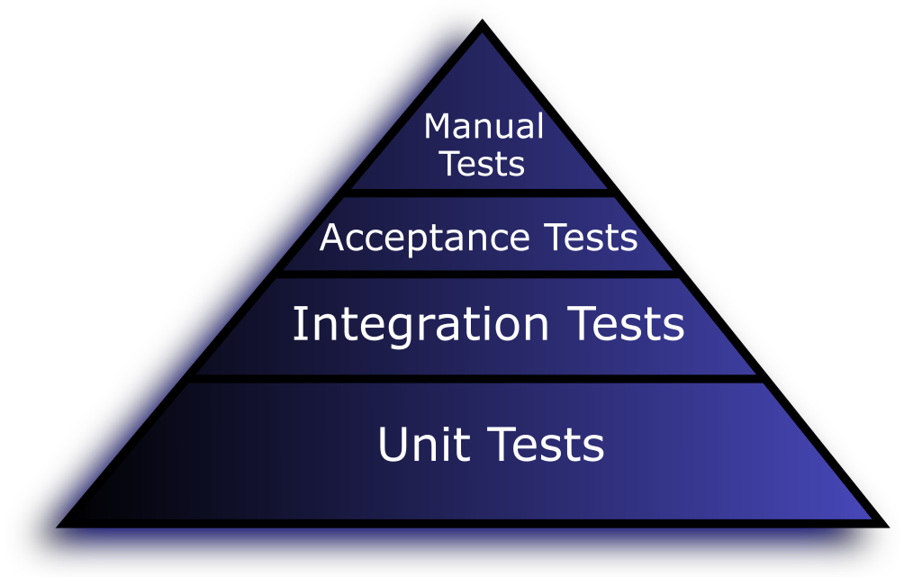
The Testing Triangle
Notes:
Note that a broad explanation of the feature being built is included at the top
Your scenario should be concise and be a concrete example with real values
Also note that gherkin syntax is almost the same as regular English
The whole feature file forms part of the executable specification of your application

Slide 11
Exercise 1 – Write a scenario
Using gherkin syntax, write a scenario for each requirement listed below on the checkout feature in order to calculate the total amount due.
A customer picks up two loaves of bread (R12.99 each) and a 2l bottle of soda (R14.99 rand each) and chooses to checkout
A customer got 1.5 kg of chicken from the butchery section @R32.90/kg and chooses to checkout
Notes:
A simple example is already included on the checkout.feature file to use as a reference
The tasks are on the feature file as well
Give a brief overview of the project structure and show to run a cucumber test

Slide 12
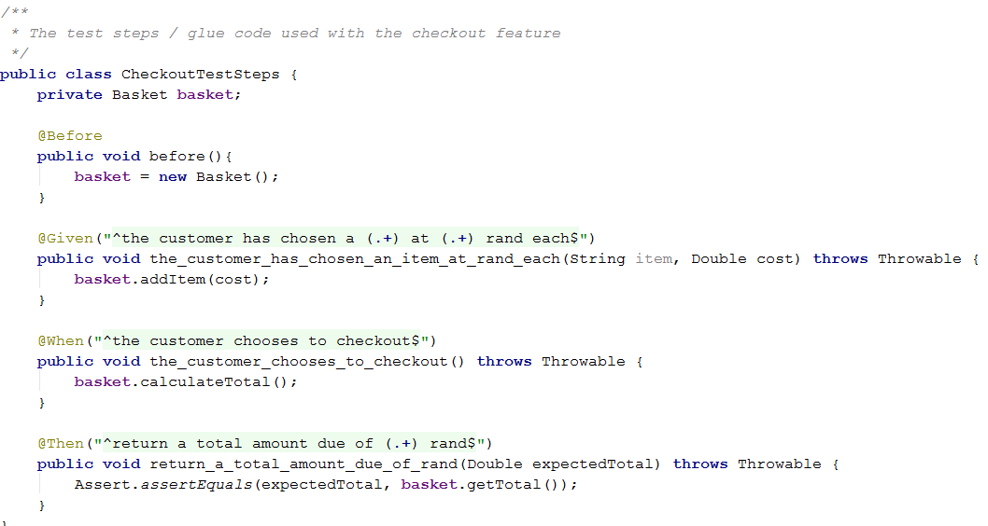
The cucumber components Glue code
Notes:
Glue code ties your gherkin syntax and code together
Uses regex to match your scenario steps and execute a code snippet
Cucumber will try to auto cast the parameter types for you e.g. String to Double

Slide 13
Exercise 2 – Glue it together
The product owner has requested additional functionality that allows a customer to check out with more than one item of the same type
You will need to add to or change the glue code so that the new scenario step triggers it
Notes:
The code to make this test pass already exists
You just need to glue everything together

Slide 14
The cucumber components Sticking it all together
What have we seen thus far?
Feature files holds easy to read scenarios outlining what we want to build
Glue code points the structured English used in the feature file to the code snippets required to make them do something
Actual code is executed by the glue code in order to make the tests pass

Slide 15
Exercise 3
The product owner has requested new functionality to be added that caters for a “two for the price of one” special offer on all chocolate bars during the month of September. The bar price is R10.
You will need to:
Create the scenarios (more than one) in the feature file using gherkin syntax
Implement the glue code that matches the gherkin syntax
Use TDD to implement the code that will make your test pass
DateTime newSystemDate = new DateTime().withMonthOfYear(Month.valueOf(currentMonth).getValue())
Notes:
This exercise is the meat of the DOJO. Allow ample time for it to be completed
Both positive and negative scenarios need to catered for (e.g. When the current month is September and when it is not)

Slide 16
The cucumber components Test automation
Cucumber allows for test automation using parameter tables
Great for bulk testing
Not to be confused with full blown test automation

Slide 17
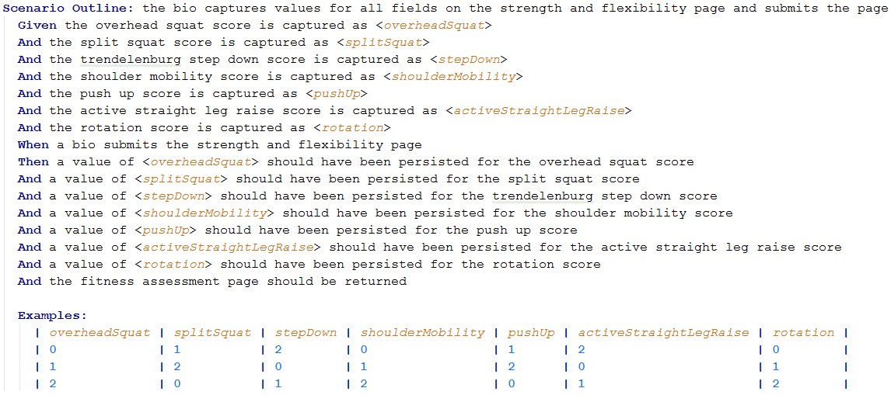
The cucumber components Test automation
Notes:
Note the column names and <> parameters that are plugged into the scenario
Only one scenario, but many examples
The number of examples is up to you, but remember more examples now means more refactoring later
NB: Note senario “outline” keyword

Slide 18
Exercise 4
We have decided to implement the per kilogram pricing model for meats as described in the first exercise.
Create a scenario to outline with multiple (minimum of 5) test examples in order to test various scenarios for different prices and quantities for chicken. Include fractional masses.
Notes:
Suggest at least 5 examples

Slide 19
Drawbacks to BDD / Cucumber
Writing down all scenarios up front takes time
Developers are more involved in test data / test case changes
Moderate learning curve
Gherkin syntax can get tricky
Duplicate steps definitions
Complex scenarios
Glue code can get complex /messy
Often requires test code refactoring

